Slide 1

Exploring Satellites in Space Data Driven Story of Orbit and Purpose
Group 10
Rohith Reddy Bollareddy 11524984
Amrutha Veeramachaneni 11511276
Raja Yaswanth Varma Vegesna 11640007
Harish Kumar Manthoju 11514879

Slide 2

Motivation:
This project uses data analysis and visualization tools to shed light on the world of orbiting satellites. This project's objective is to give users a platform to browse and study satellite data stored in the UCS satellite database.
Significance:
The data-driven analysis and visualization of the data gathering can aid in comprehending the patterns and relationships between various satellite variables. With the aid of this data, researchers, engineers, governmental organizations, other stakeholders, and businesses engaged in space technology may all more easily access and assess data.

Slide 3

Objectives:
To understand how satellites are distributed across different countries and organizations.
To extract the precise function of satellites in orbit.
Examine satellite orbits and the various orbital trajectories that they employ.
To acknowledge the countries and companies involved in satellite construction and launch.
To scan the links and patterns between the several satellite variables.

Slide 4

Features:
A user-friendly interface calling the platform will have a user-friendly interface that allows users to search, analyze, and visualize satellite data easily.
Data sharing: the platform will enable users to share data and collaborate on research projects.
Safety and sustainability: the platform will include information on the safety and sustainability of satellite systems, such as Collision risk and space debris.

Slide 5

Implementation: Tools:
Python: We have used python to preprocess the data and performed some EDA to know more about the dataset in general.
Tableau: It is used to generate charts corresponding to the dataset, create calculated fields, user defined functions for extracting the information we needed.
D3.js: We used D3.js for creating a few box plots, scatter plots.
VizHub: Used to create graphics and data visualizations with web technologies.
GitHub: We create a GIST for the chosen cleaned dataset which can be used to maintain the dataset publicly.

Slide 6
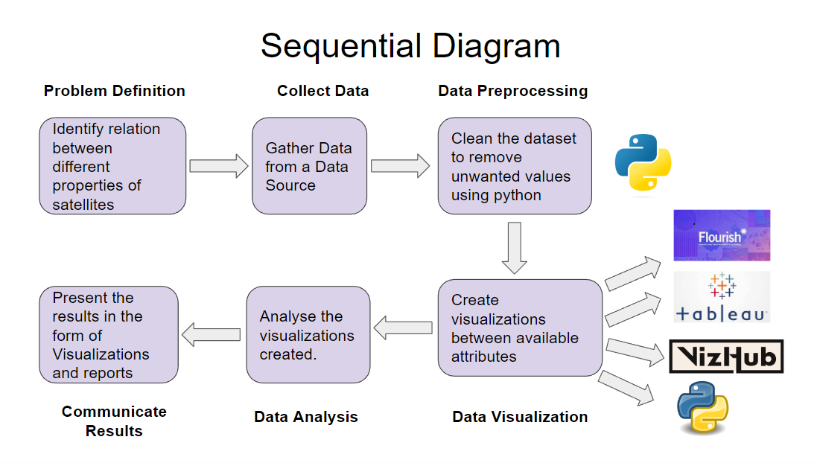
Workflow Diagram

Slide 7
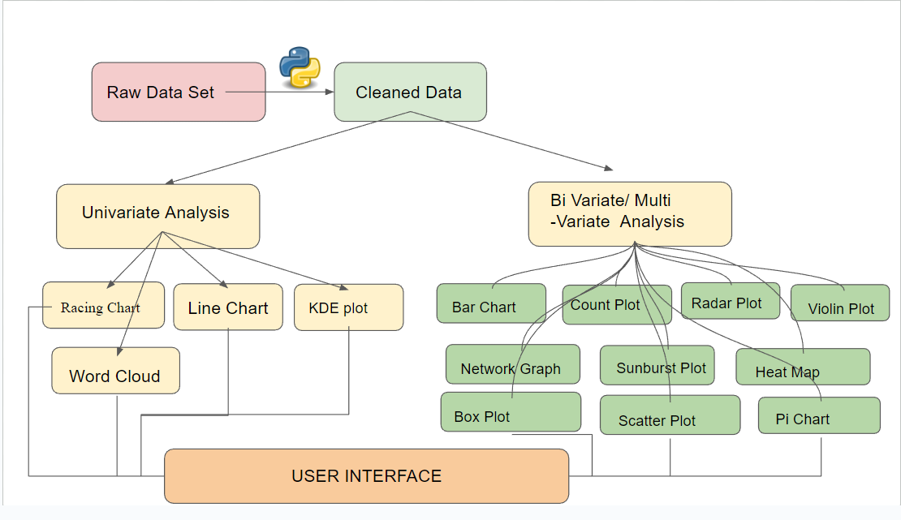
Feature Diagram

Slide 8
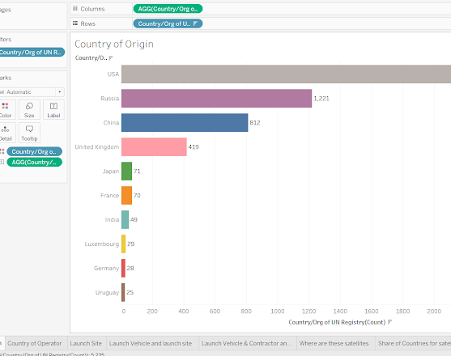
Bar Chart for Country of Origin
Fig 1

Slide 9
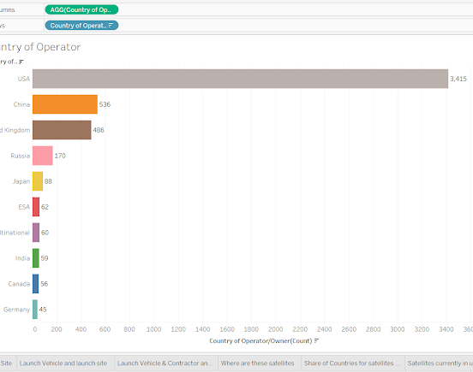
Bar Chart for Country of Operator
Fig 2

Slide 10
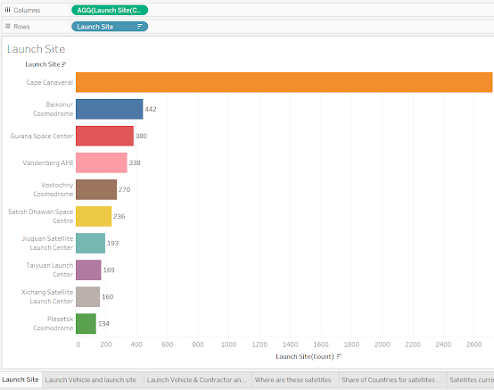
Bar Chart for Launch Site
Fig 3

Slide 11
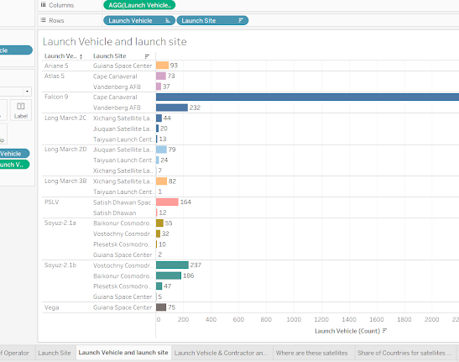
Bar Chart for Launch Vehicle and Launch Site
Fig 4

Slide 12
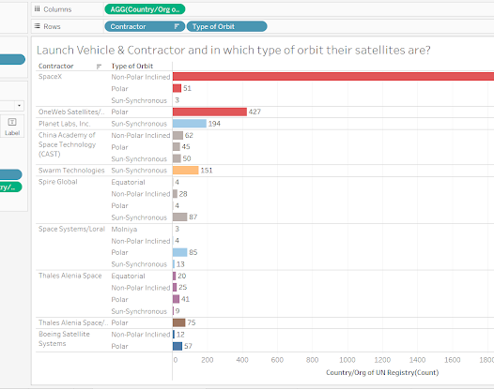
Bar Chart for Launch Vehicle and Contractor and in which type of orbit their satellites are
Fig 5

Slide 13
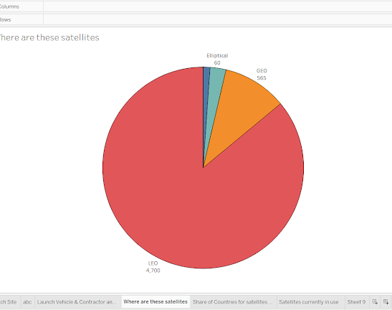
Pichart for the Class of Orbit
Fig 6

Slide 14
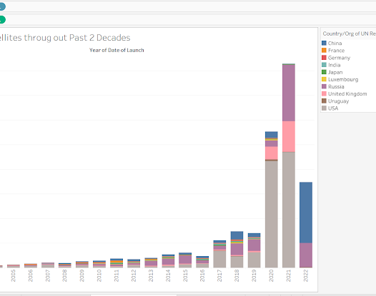
Stacked Bar for share of Countries for satellites over Past 2 Decades
Fig 7

Slide 15
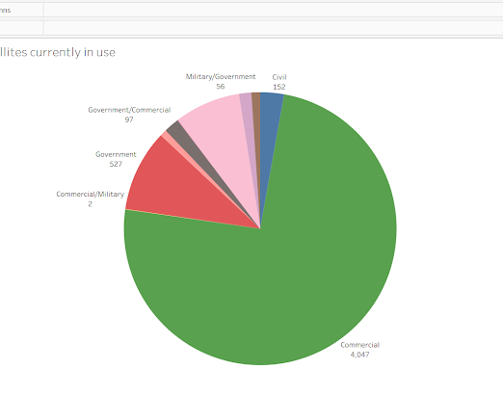
Pie chart for visualizing the purpose
Fig 8

Slide 16
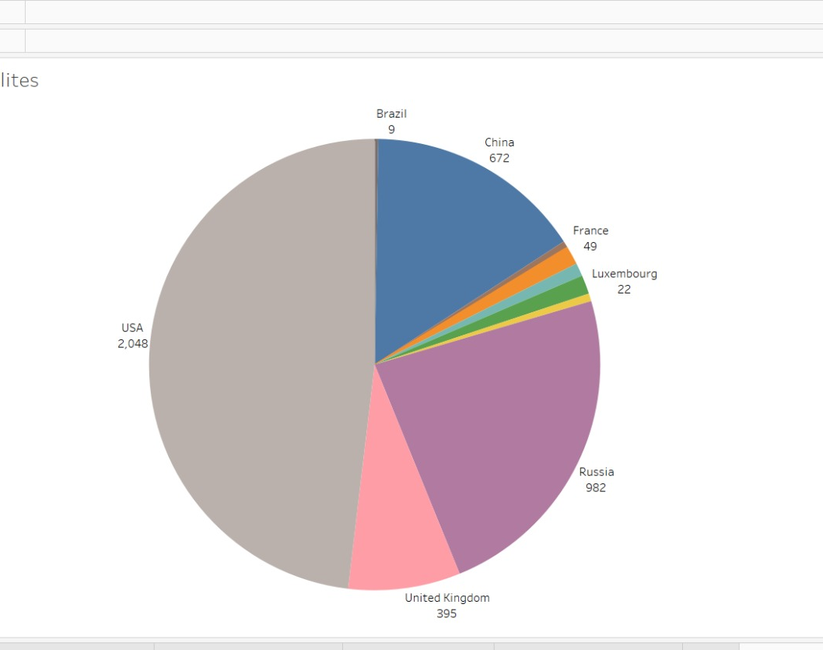
Pie chart for visualizing the purpose of the Satellite

Slide 17
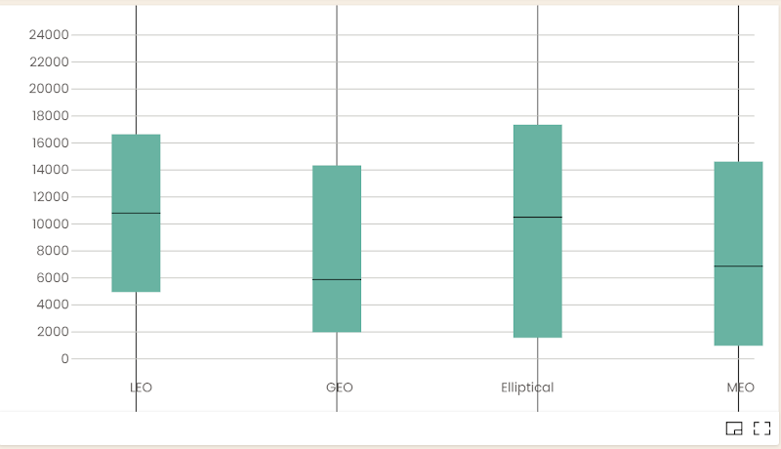
Box plot for Dry Mass and Class Of Orbit
Fig 9

Slide 18
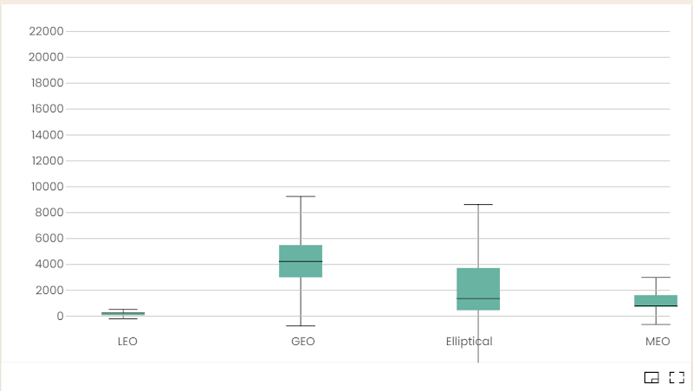
Box plot for Launch Mass and Class of Orbit
Fig 10

Slide 19
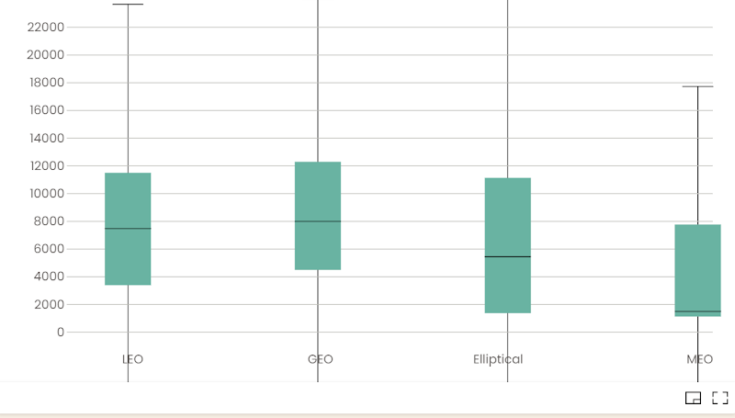
Box plot for Power(Watts) and Class Of Orbit
Fig 11

Slide 20
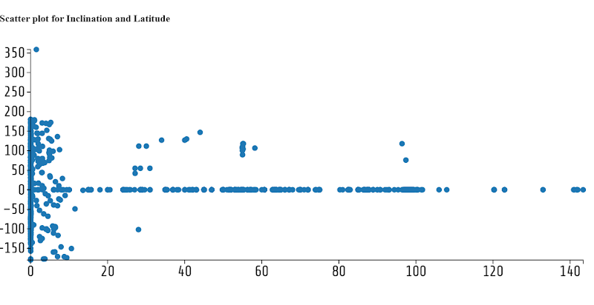
Scatter plot for Inclination and Latitude
Fig 12

Slide 21
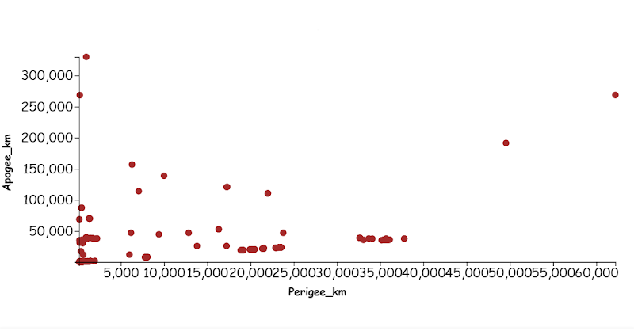
Scatter plot for Perigee and Apogee
Fig 13

Slide 22
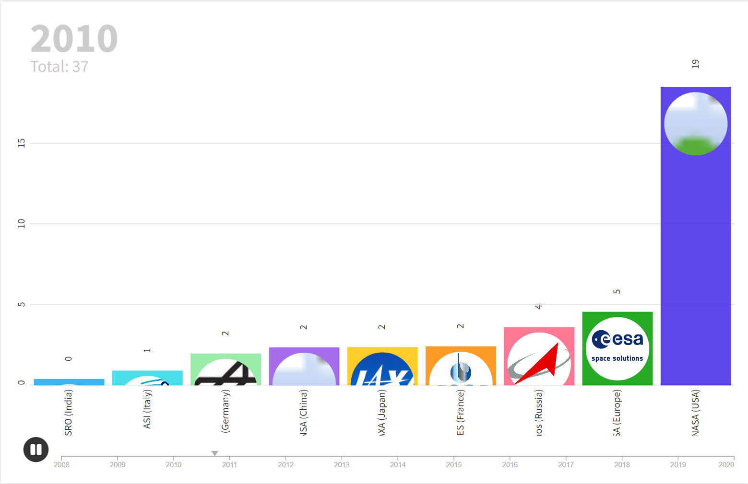
Space Budgets Over Time

Slide 23
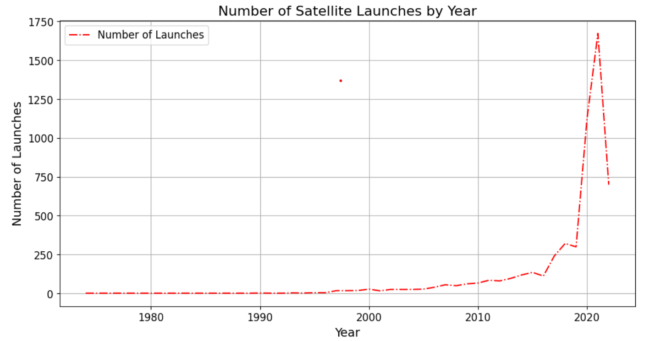
Number of Satellite Launches Per Year

Slide 24
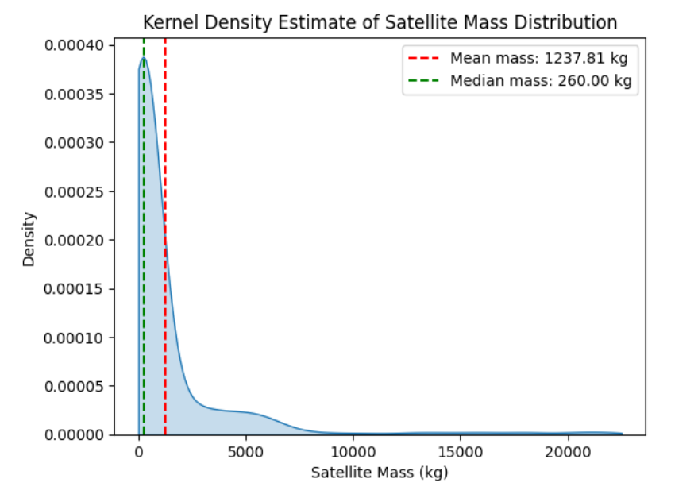
Kernel Density Estimate of Satellite Mass Distribution

Slide 25
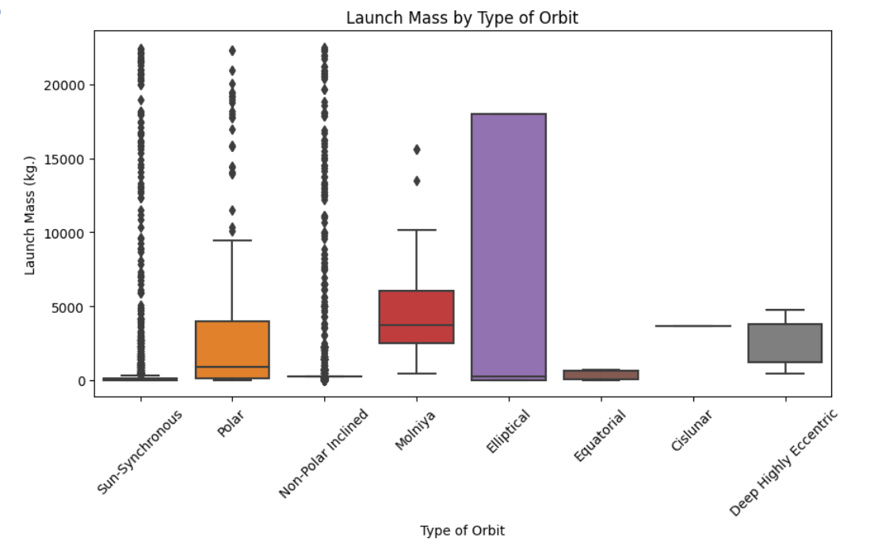
Launch Mass by Type of Orbit

Slide 26
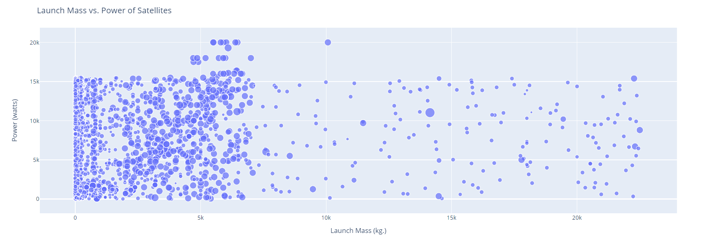
Launch Mass vs. Power Of Satellites

Slide 27
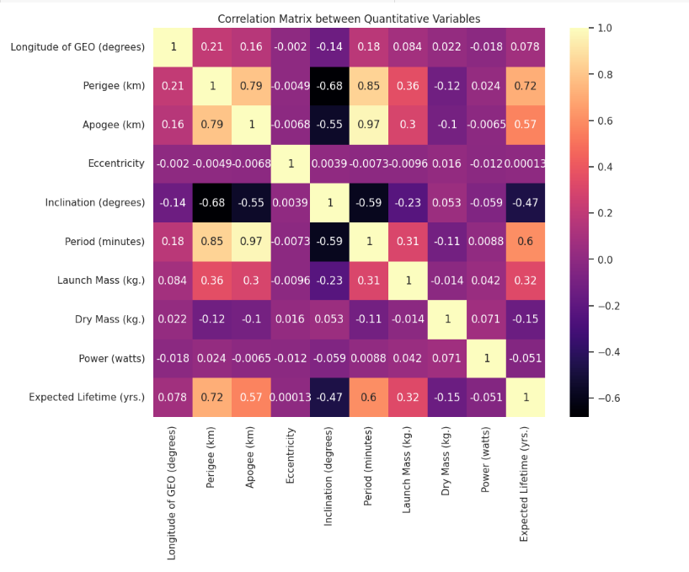
Correlation Matrix between Quantitative Variables

Slide 28
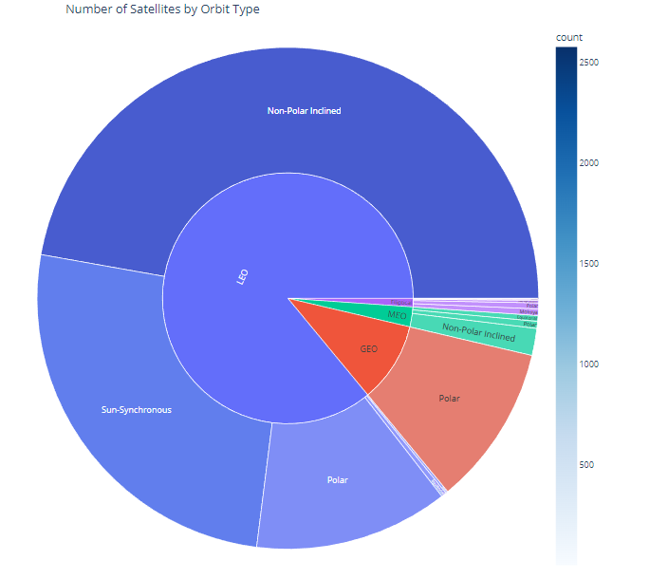
Number of Satellites by Orbit Type

Slide 29
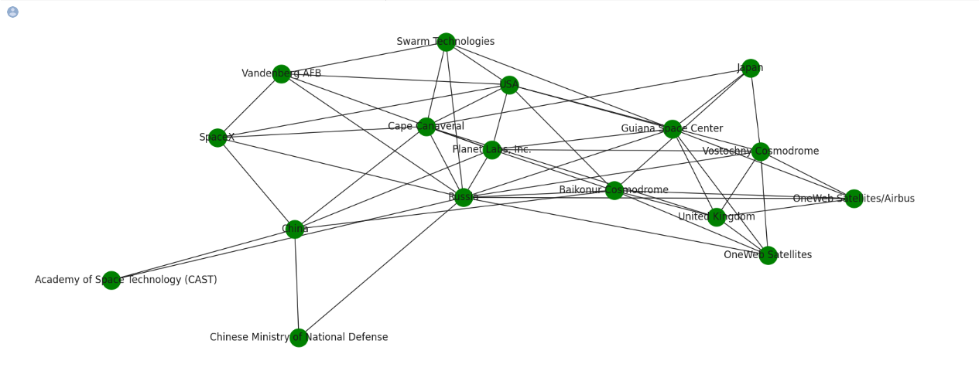
Network graph for top 5 Contactors, Launch Sites, Operator/Owner- top 5

Slide 30
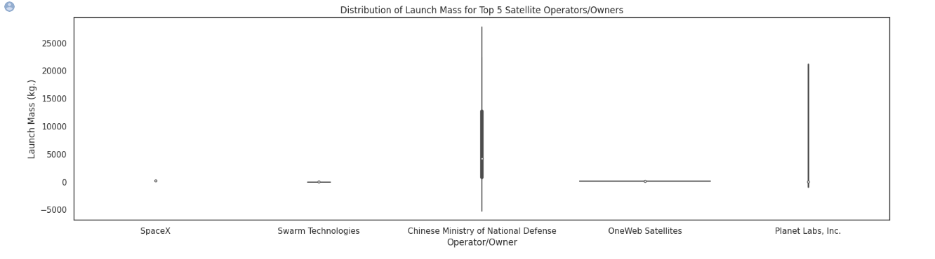
Distribution of Launch Mass for Top 5 Satellite Operators/Owners

Slide 31
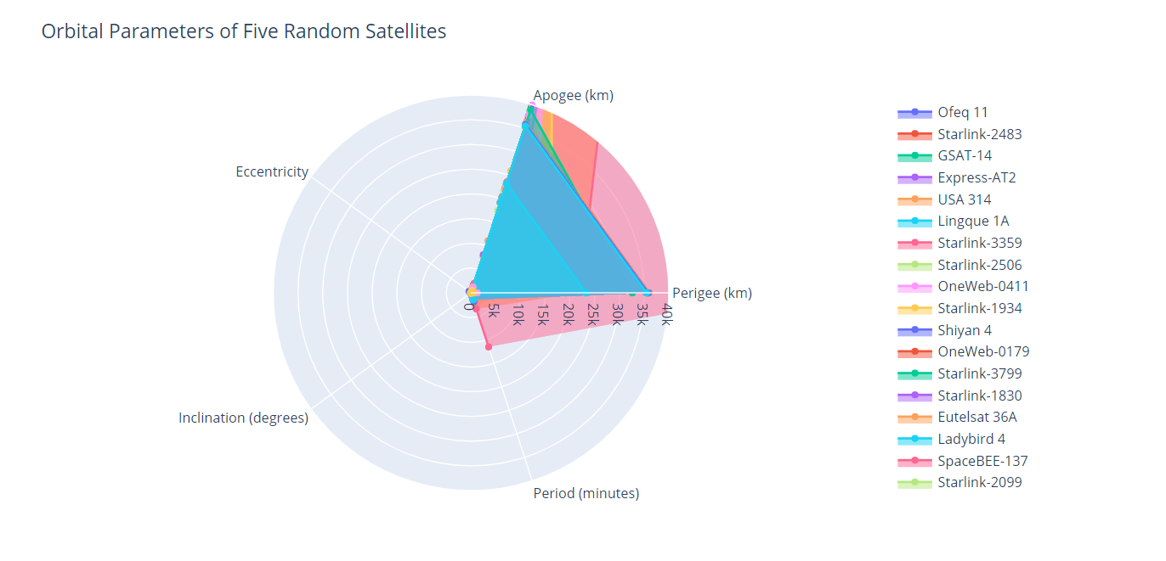
Orbital Parameters of Five Random Satellites

Slide 32
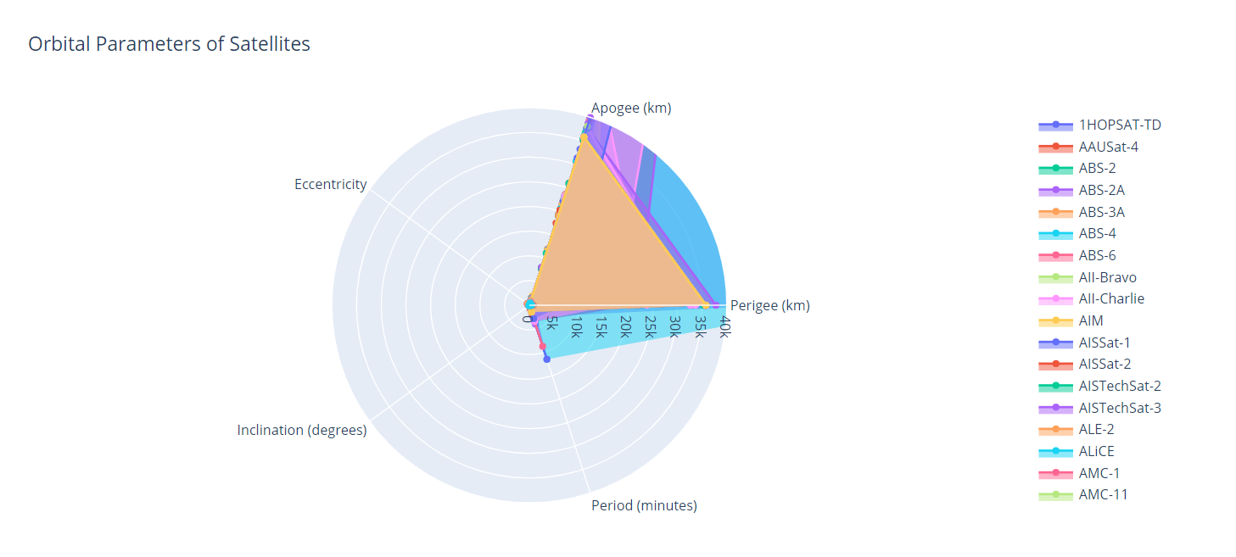
Orbital Parameters of Satellites

Slide 33
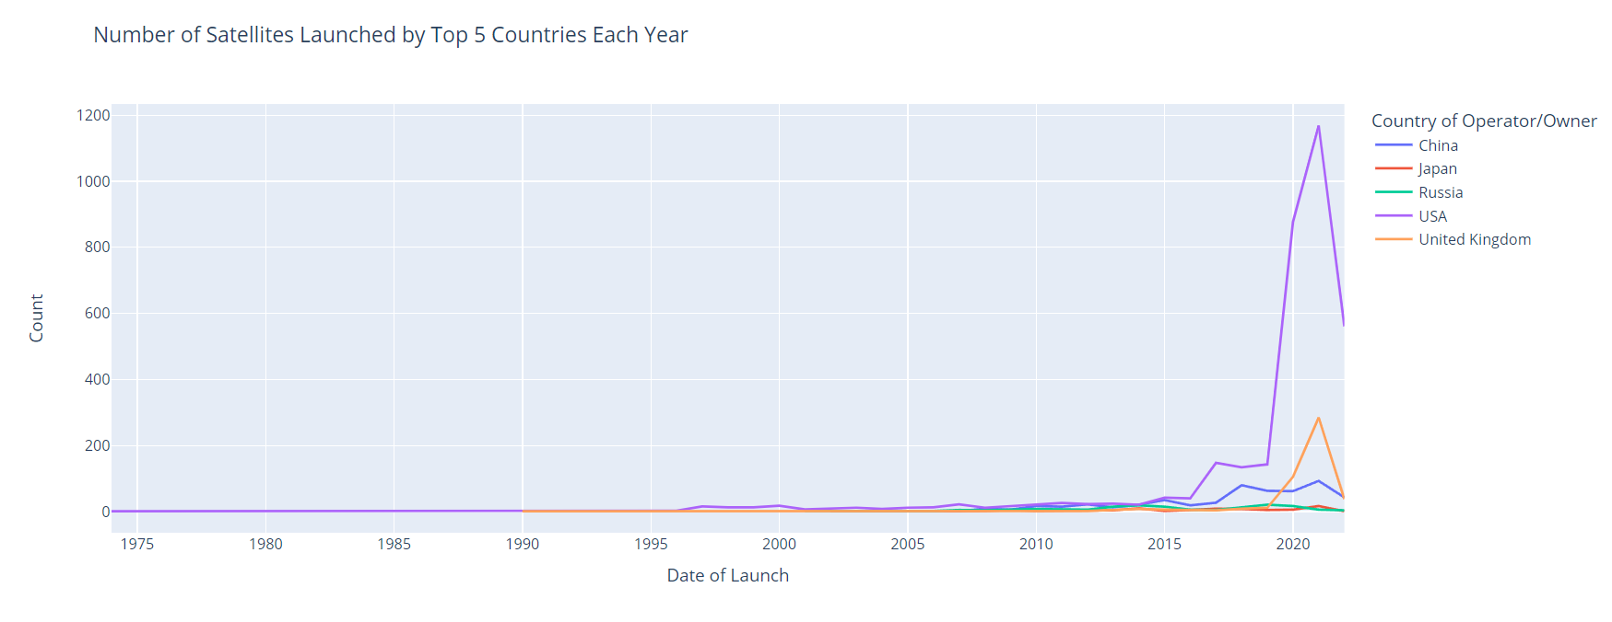
Number of Satellites Launched by Top5 Countries Each Year

Slide 34
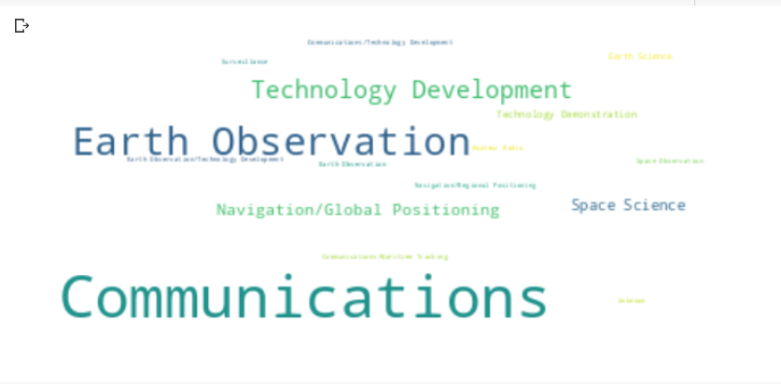
Top Satellites uses by purpose

Slide 35
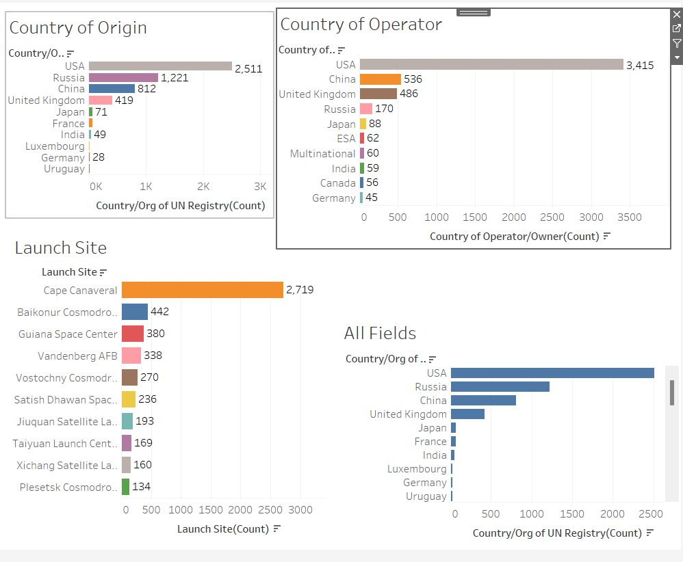
Dashboard

Slide 36
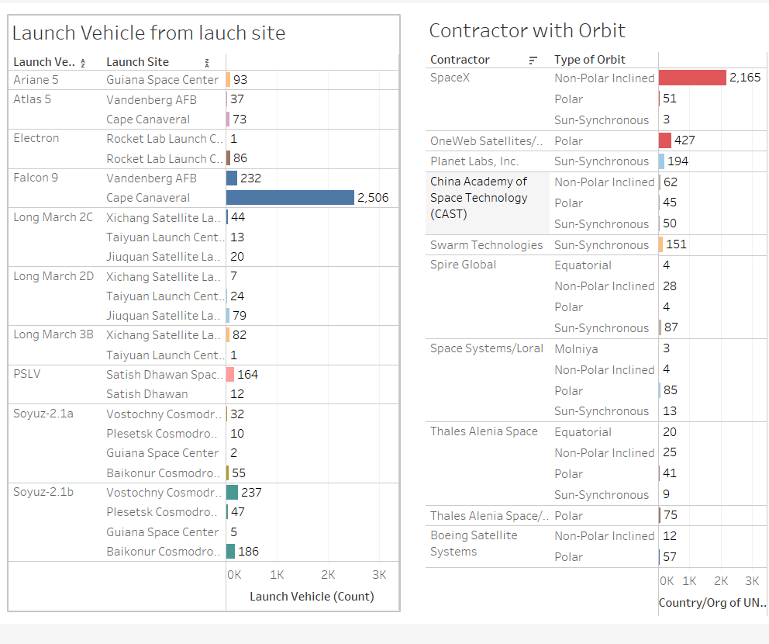
Dashboard

Slide 37
REFERENCE'S :
Data: https://www.ucsusa.org/resources/satellite-database
https://www.visualcapitalist.com/visualizing-all-of-earths-satellites/
https://www.esri.com/arcgis-blog/products/js-api-arcgis/3d-gis/earths-satellites/
https://www.visualcapitalist.com/high-level-look-at-satellites/
Python Libraries: https://docs.python.org/3/library/
D3.js API Reference Documentation: https://github.com/d3/d3/blob/main/API.md
Tableau Documentation: https://help.tableau.com/current/pro/desktop/en-us/gettingstarted_overview.htm
Code : Code File-Pyhton
Time Line graph: Time Line racing chart

Slide 38
THANK YOU !

